Slide 1
Sales Accreditation Summary Modules 3 & 4
Al-Futtaim Automotive Talent Centre
Date 21/08/2025

Slide 2
Product Presentation – What do I need to know?
Know your customer’s needs and wants
Use all the gathered information during the previous steps in the sales process (Lead Management, Matching needs to product)
Complete all available product training
Make a commitment to continual study and practice
Other manufacturers’ websites
Third-party consumer websites
Automotive enthusiast publications and websites
Newspaper or magazine automotive reviews
Know your product and the competitors
Develop interactive, confident presentation skills
Use the SPECIT & FFBA methods to support your presentation

Slide 3

Product Presentation
FFBA
FEATURES ARE ONLY USEFUL IF THEY RELATE TO THE CUSTOMERS NEEDS AND WANTS
Feature | Function | Benefit | Advantage
What the product/service has | What it does | Why it matters to the customer | Why it’s better than alternative

Slide 4







Product Presentation - SPECIT
S
Safety & Security
P
Performance
E
Economy, Environment or Electrification
SPECIT
C
Comfort & Convenience
I
Image
T
Technology

Slide 5

THE EXCEPTIONAL TEST DRIVE
Remember
WHAT NOT TO DO DURING A TEST DRIVE:
Not knowing answers to product questions
Rushing through the test drive
Test driving a dirty or imperfect vehicle
Talking too much during the test drive

Slide 6
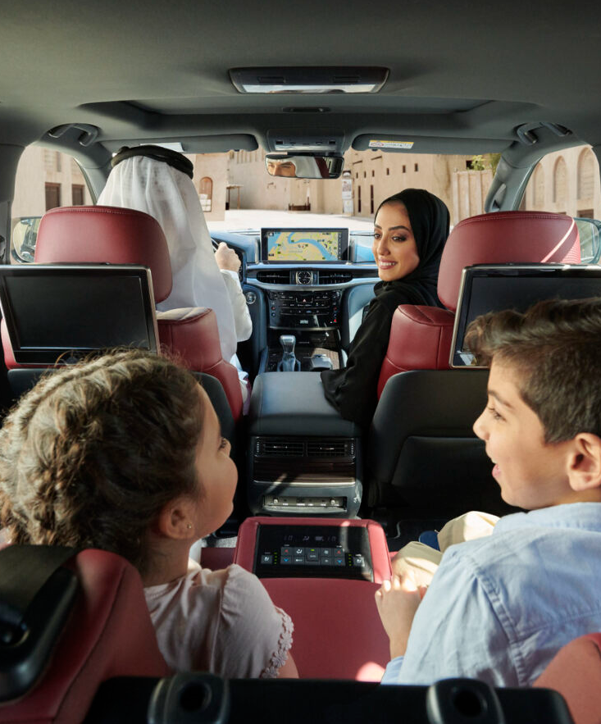
THE EXCEPTIONAL TEST DRIVE
HOW TO PREPARE FOR THE TEST-DRIVE?
Prepare
Vehicle is Clean (Inside & Outside)
The route is set
Vehicle is ready to drive
You know what features to stress on
Documentations done
Drive
Switch
Feedback

Slide 7
THE EXCEPTIONAL TEST DRIVE
HOW TO PERFORM THE TEST-DRIVE?
Prepare
Start the test drive by driving the car and the customer in the passenger seat
Describe the route and why you chose it
Show the customer how all or most of the features are working
Answer any questions
Drive
Switch
Feedback

Slide 8
THE EXCEPTIONAL TEST DRIVE
HOW TO STRUCTURE THE TEST-DRIVE?
Prepare
Switch places and let the customer drive
DO NOT TALK or describe any further feature
Let the customer enjoy the drive silently
ONLY answer the customer’s questions
Drive
Switch
Feedback

Slide 9
THE EXCEPTIONAL TEST DRIVE
HOW TO TRIAL CLOSE AFTER THE TEST-DRIVE?
Prepare
Well, looks like you have found your next car, right?
So, was it everything you were looking for in your next car or anything missing?
So, are we ready to move forward?
Let's go inside and talk, if we have right the car for you.
Are you ready to go inside and work about the details so you can take it home as soon as possible?
Drive
Switch
Feedback

Slide 10
OBJECTION HANDLING TECHNIQUE
APAC Objection Handling Framework
Step | Description | Purpose | Example
Acknowledge | Recognize the objection without arguing or dismissing it. | Builds trust and shows empathy. | “I understand why that might be a concern.”
Probe | Ask clarifying questions to uncover the root cause of the objection. | Helps you understand the real issue behind the objection. | “Can you tell me more about what specifically worries you about the cost?”
Answer | Address the objection with relevant facts, benefits, or solutions. | Resolves the concern with tailored information. | “Actually, the total cost includes post-sale support and free upgrades for 2 years.”
Confirm | Check if the objection has been resolved and move forward. | Ensures alignment and readiness to proceed. | “Does that address your concern? Can we move to the next step?”

Slide 11
Negotiation & Closing
Seek a WIN-WIN!
HIGH
WIN / LOSE
WIN / WIN
Consideration
LOSE / LOSE
LOSE / WIN
LOW
Courage
HIGH

Slide 12
Negotiations
What can I trade?
What should I do?
Vehicle Options/ Grade
Service Plans
Referrals / Loyalty
Re-sale value*
Accessories
Extended Warranty
Finance Options/ Term / Drive on Lease
Event Tickets / VIP access
FAB Credit Card / Blue Rewards
Be confident
Have a negotiation strategy
Quote your price, then be quiet!
Seek a win/win outcome
Customer feels positive about the deal
Value yourself, your time & your product
Negotiate at the right time & place
Only enter negotiation after a positive trial close response
Answer questions promptly with confidence

Slide 13

FINAL CLOSE EXAMPLES
Direct Close
A direct question
“Are you happy to go ahead?”
Assumptive Close
Acting as though the deal is already done.
“So you’d like it in Mica Black then?”
Alternative Close
Like the assumptive, but with a choice.
“Would you like to go for the VXR or GR-S grade?”
Notes:
KEY POINTS
The ideal outcome of negotiation is one where both parties feel like they have a good deal – the prospect of long a term-relationship and referrals is high.
In order to stop negotiation being solely about price, we should consider the ‘tradeables’ we and the customer have to offer.
In order to negotiate effectively you should be prepared with a strategy, have confidence, value yourself and the product and only enter negotiation after you have been through the process of needs based selling.

Slide 14
FINAL CLOSE EXAMPLES CONTINUED….
1,2,3 Close
Summarise the value / benefits in sets of 3…
“I can get you the X model, with premium audio system, the 21” wheels and the Platinum paint for X-AED are you happy to go ahead?”
Yes Close
Pull on the trial closes to get them to say “YES” 3 times…
“You need the car by the 20th next month? You liked the sport model I showed you? You want it with the side steps, right? Great, if I can get you all of this will you be happy to buy?”
No Hassle Close
Taking all the hassle away from the customer…
Take a seat, I’ll get you another coffee, ill print this order with everything you’ve told me you want all you need to do is sign and the deals done…

Slide 15
Thank you!
See you next time!
Contact
Fatma Alsagaf Learning & Development Consultant
Al-Futtaim Automotive Talent Centre, Dubai, UAE
E-mail: Fatma.Alsagaf@alfuttaim.com

